Slide 1
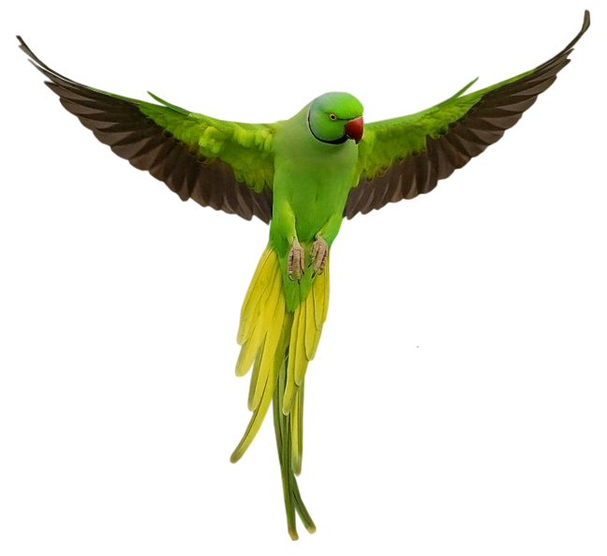

TITAN X
ITRW 311
Pets4U

Slide 2
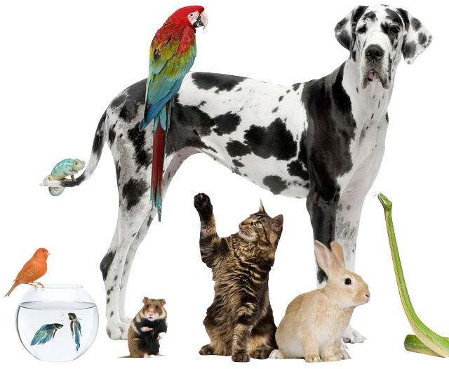
THE TEAM
Documentation:
M.R.M Moripe 26906953
M Vermeulen 26751283
A Hendriks 20208499
Database Design & Build:
K Kau 26904020
W.G Erasmus 26269163

Slide 3
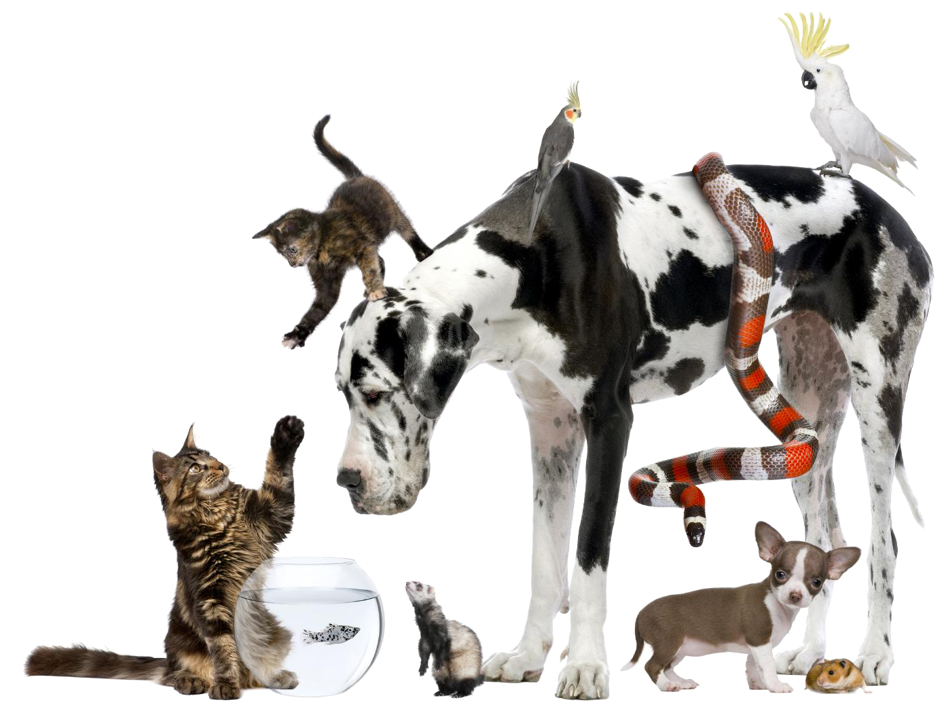
THE TEAM
Application Designers:
N Hefer 26098903
R Hammond 26240343
The Programmers:
B Lubbe 24928410
D Pieterse 27740757
L Wassenaar 25948083

Slide 4
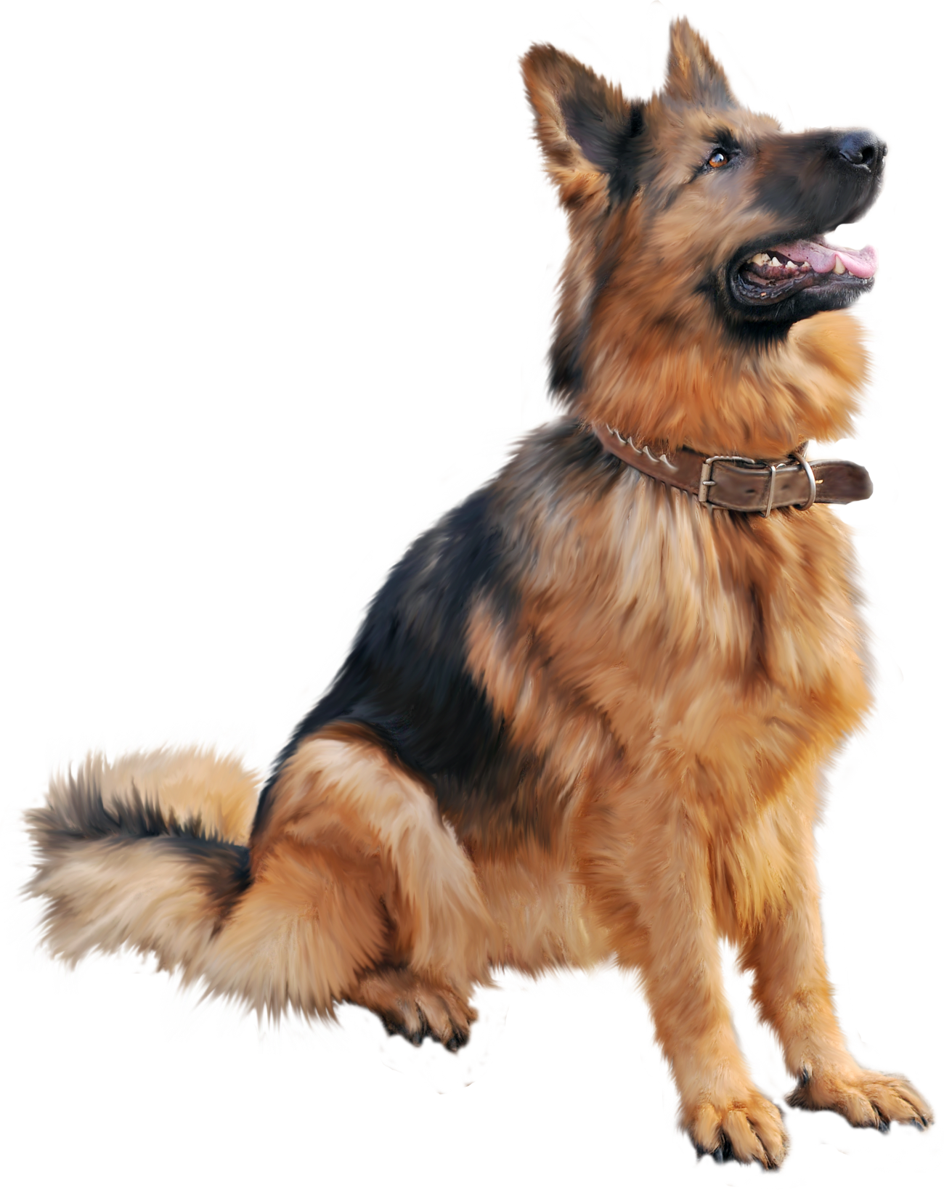
Project Description
Our system will be used by Pets4U to:
Manage Appointments
Keep track of the supplies in stock
Contain information of the different clinics and their staff
Help manage productivity and effectiveness
Help with communication

Slide 5
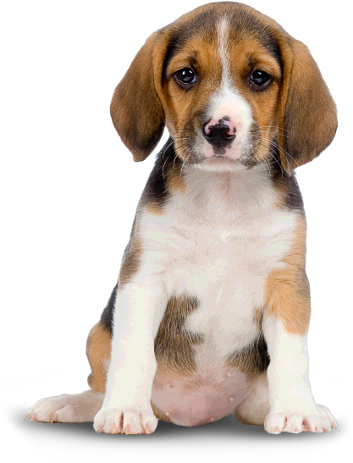
System Requirements
Record appointment made
Record examinations
Record treatments of pets
Record information of new employee
Record a clinic’s information
Record information of a pet
Record information of a pet owner
Record pets admitted to pens
Search pet owner
Calculate price on invoice
Record supplies (pharmaceutical, surgical and non-surgical)
View staff information

Slide 6

Conceptual Design

Slide 7
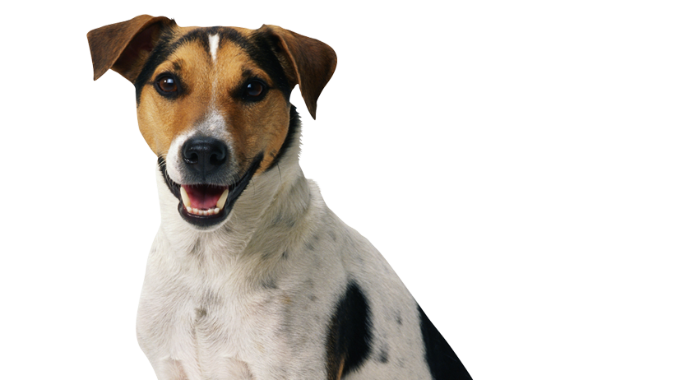
Logical Design

Slide 8
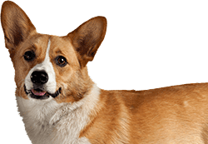
Physical Design

Slide 9

Reversed Engineer ERD

Slide 10

Data Flow Diagram (DFD)

Slide 11
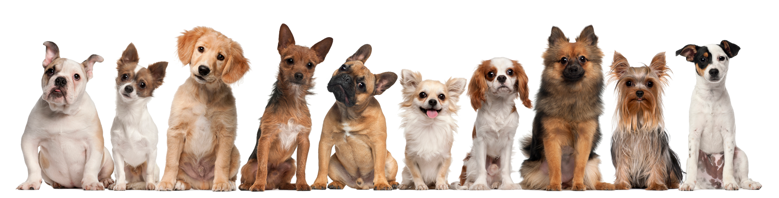
Prototype

